Slide 1
UI and Front end
Our steps and progress in UI and Front End phase.

Slide 2
Designing UI Steps:
Step 1
Research the competition
Step 2
Sketch out Initial Layout
Step 3
Designing the pages

Slide 3
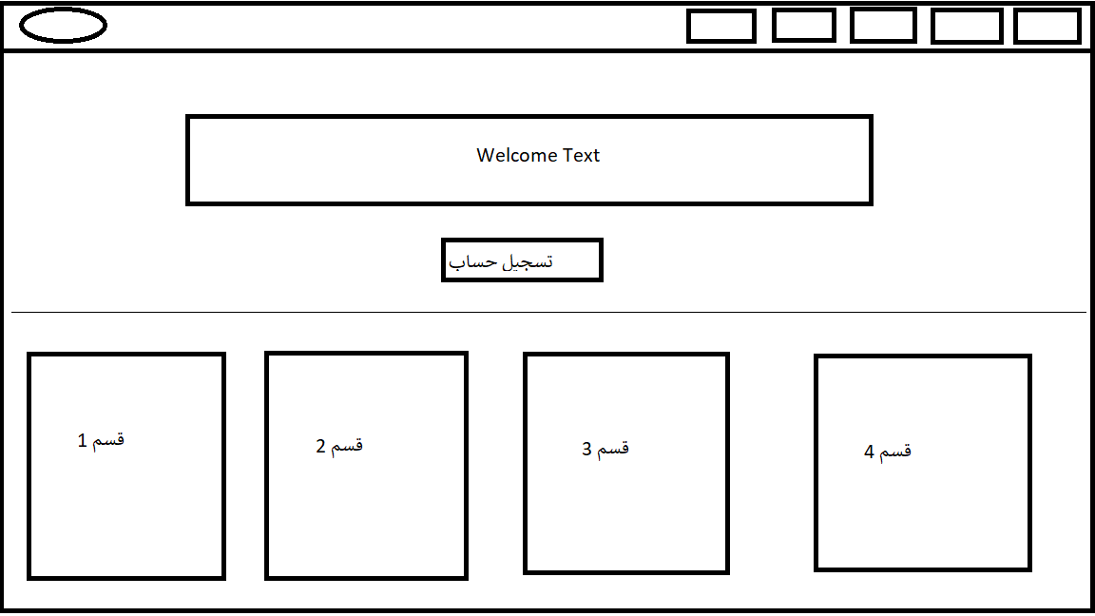
Step 2
Home page layout

Slide 4
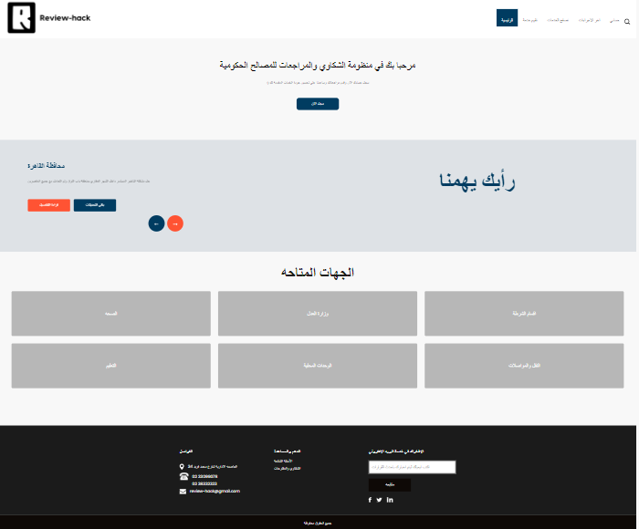
Step 3
Home Page :

Slide 5
Technologies
HTML
CSS
Bootstrap
JavaScript
Responsive Front End Pages
(Desktop,Tablet,Mobile)
accessibility front end development
(Tabs ,Font Resize,Dark Theme)
front-end performance
(Compress the files, caching in local storage)
Front End live Demo : https://ahmedbadrshaban.github.io/

